Slide 1
DGCRN: Dynamic Graph Convolutional Recurrent Network for Traffic Prediction: Benchmark and Solution
Citation:
Li, F., Feng, J., Yan, H., Jin, G., Jin, D., & Li, Y. (2021). Dynamic Graph Convolutional Recurrent Network for Traffic Prediction: Benchmark and Solution. ArXiv, abs/2104.14917.

Slide 2
Background
Traffic data shows strong dynamic correlations in the spatial and temporal dimension, it is crucial to model dynamic and nonlinear spatio-temporal correlations for accurate traffic prediction.
The spatial correlations between different locations are highly dynamic, which is determined by real-time traffic conditions and the topology of traffic network.
Meanwhile, the temporal dependencies are also complex due to the mixture of non-linear changes and periodicity.

Slide 3
Challenges
The dynamic characteristics of traffic graph topology need to be further modeled.
Most works fail to fuse static distance based graph and dynamic attribute based graph to describe the topology of traffic network from distinct perspectives, but integrating them can give model a wider range of horizon for capturing spatial dependencies. And the training speed of RNN and its variants are restricted by the inner recurrent operations.
Models and traffic datasets is increasing with rapid growing of traffic prediction field, where the models are evaluated on different datasets with corresponding experimental settings.

Slide 4
Contributions
(1) Proposed a new model called Dynamic Graph Convolutional Recurrent Network (DGCRN). In which a hypernetwork is designed to utilize and extract the dynamic characteristics of node attributes to get better prediction performance.
(2) A reproducible standardized benchmark and a new representative traffic data set for Beijing are provided for fair comparison and further study.

Slide 5
Related Works
Statistical models
Historical Average Model (HAM)
Autoregressive Integrated Moving Average model(ARIMA)
Vector Autoregression(VAR)
Traditional Machine Learning Models
Forward Neural Network(FNN)
Support Vector Machine(SVM)、Support Vector Regression(SVR)
Deep Learning Models
FC-LSTM, DCRNN, STGCN, Graph WaveNet, ST-MetaNet, AGCRN, GMAN, MTGNN, etc.

Slide 6
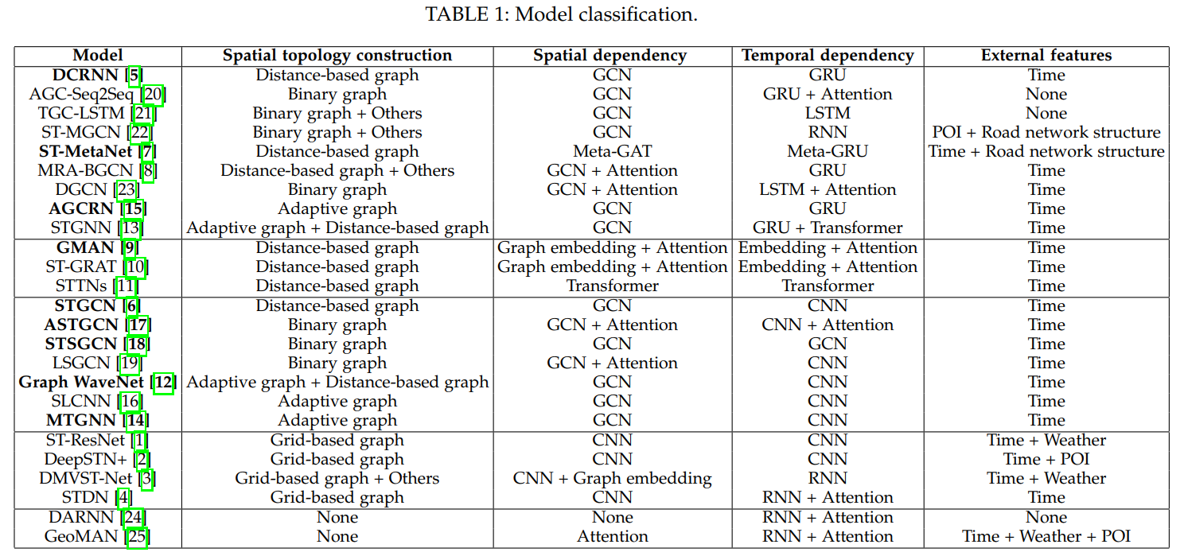
Related Works

Slide 7
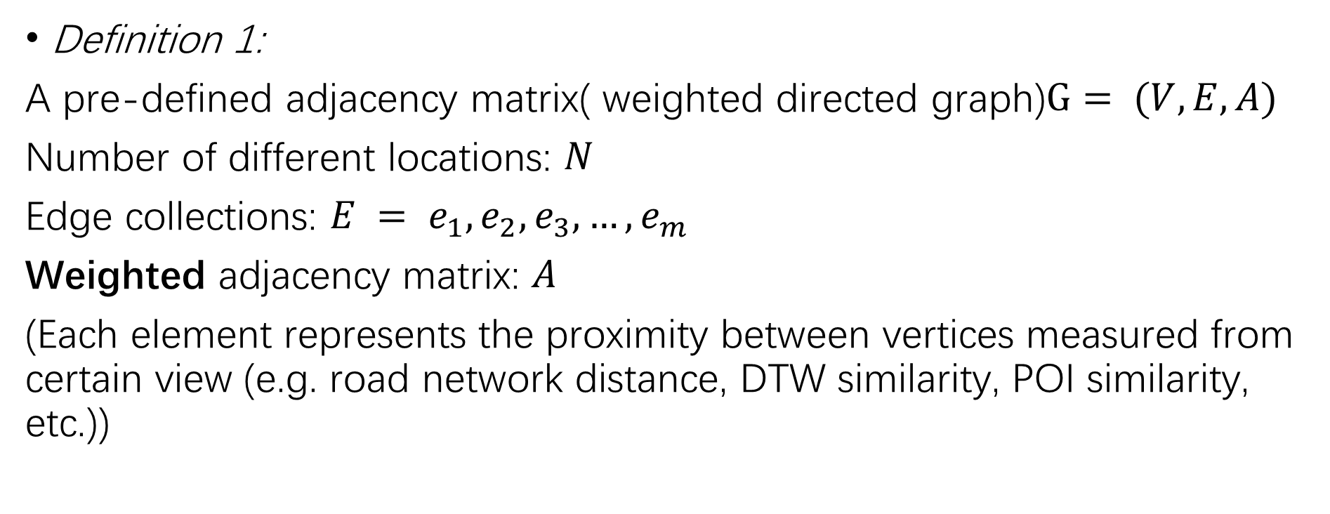
Problem Definitions
Definition 1:
A pre-defined adjacency matrix( weighted directed graph)$G= (V,E,A)$
Number of different locations: $N$
Edge collections: $E = e_{1},e_{2},e_{3},…,e_{m}$
Weighted adjacency matrix: $A$
(Each element represents the proximity between vertices measured from certain view (e.g. road network distance, DTW similarity, POI similarity, etc.))

Slide 8

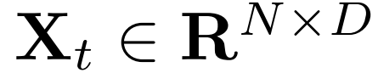
Problem Definitions
Definition 2:
The multivariate time series(graph signals)
T is the length of sequence and D is the number of features of each node (e.g., traffic volume, traffic speed, etc.).
At each time step t, the graph signal is .

Slide 9
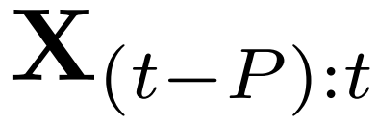
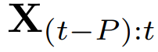
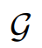
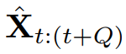
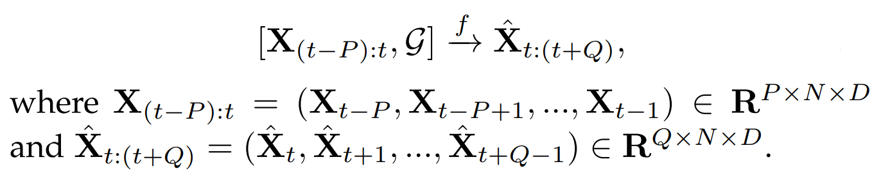
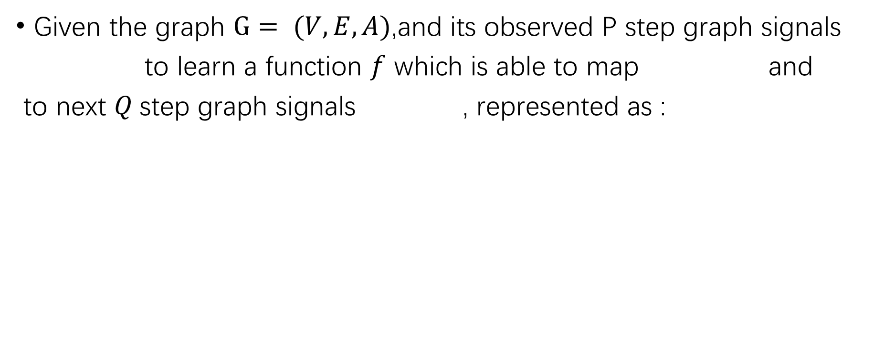
Problem Formulation
Given the graph $G= (V,E,A)$,and its observed P step graph signals
to learn a function $f$ which is able to map and
to next $Q$step graph signals , represented as :

Slide 10
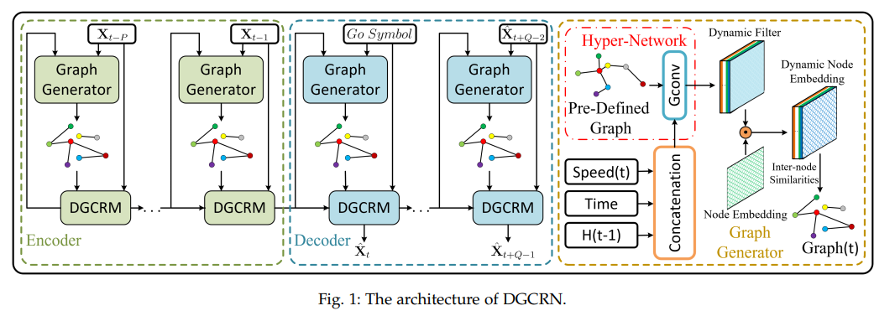
Framework

Slide 11
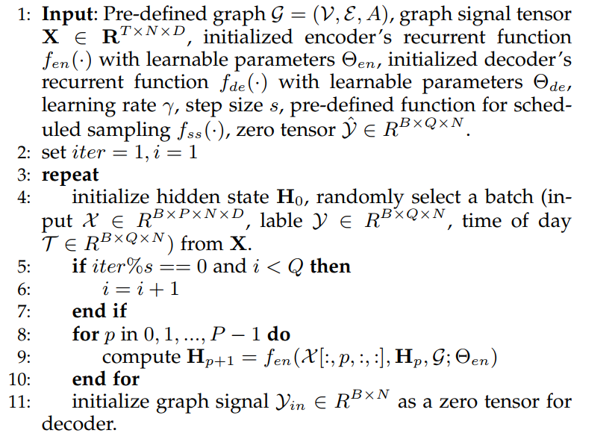
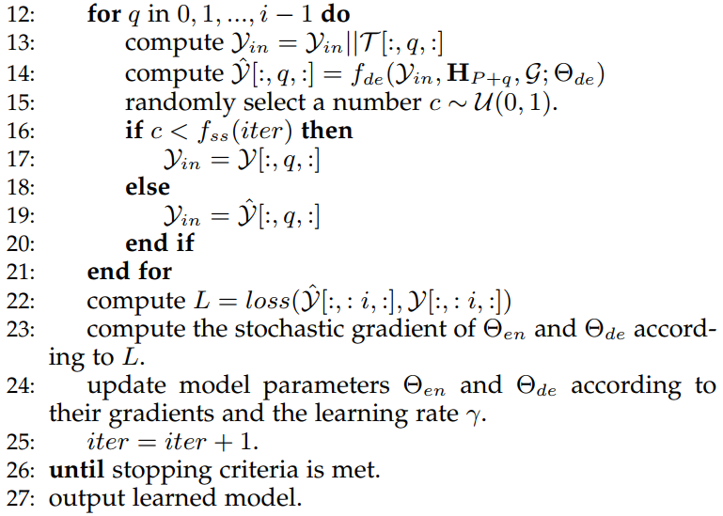
Training Algorithm of DGCRN

Slide 12
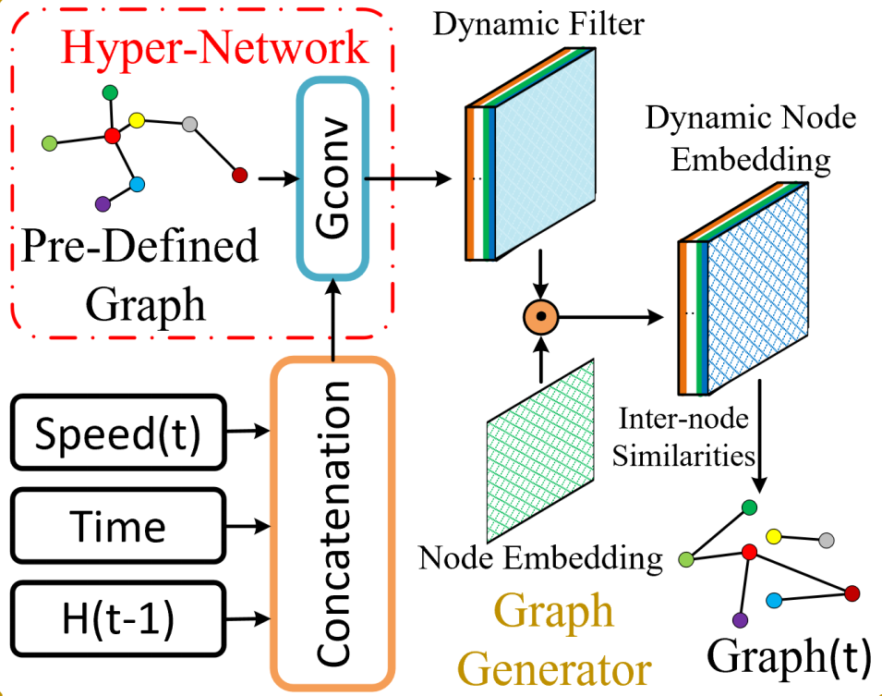
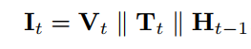
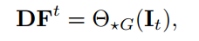
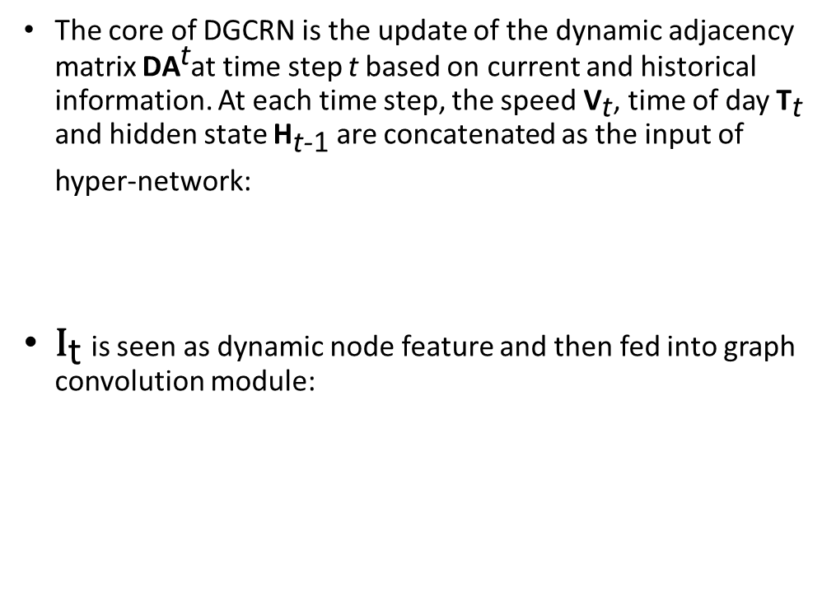
Graph Generator
The core of DGCRN is the update of the dynamic adjacency matrix ${\text{DA}}^{\text{t}}$at time step t based on current and historical information. At each time step, the speed ${\text{V}}_{\text{t}}$, time of day ${\text{T}}_{\text{t}}$ and hidden state ${\text{H}}_{\text{t}\text{−}\text{1}}$ are concatenated as the input of hyper-network:
${\text{I}}_{\text{t}}$ is seen as dynamic node feature and then fed into graph convolution module:

Slide 13
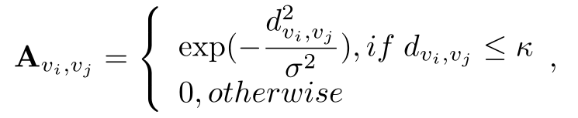
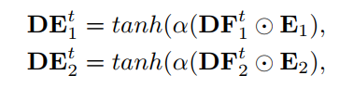
Graph Generator
In practice, we employ two hyper-networks to generate two dynamic filters for source node embedding and target node embedding respectively, denoted as follows:
We employ similarity among nodes to calculate the dynamic adjacency matrix, following:

Slide 14
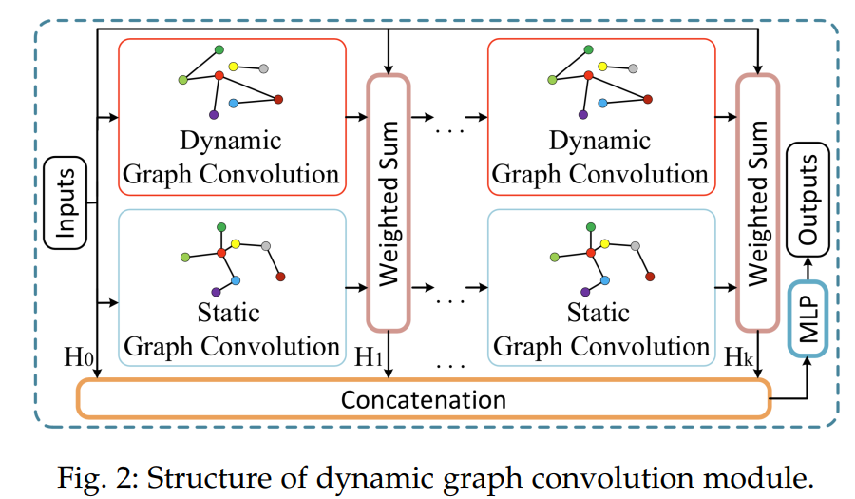
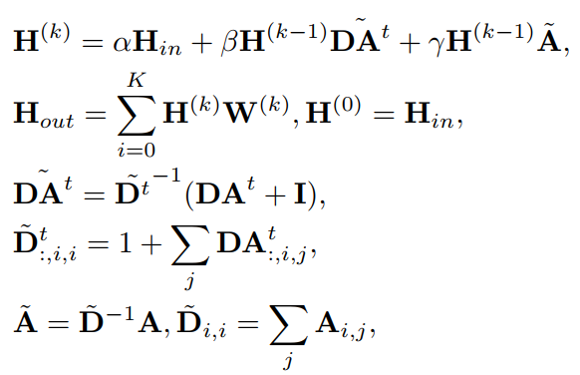
Dynamic Graph Convolutional Recurrent Module
On each graph convolution layer, the weighted summation of the graph convolution results of input graph signal, predefined static graph and dynamic graph is adopted. K-Hop dynamic graph convolution module can be expressed as:

Slide 15
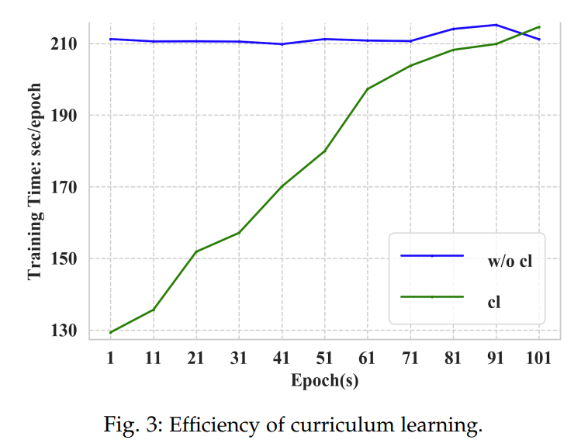
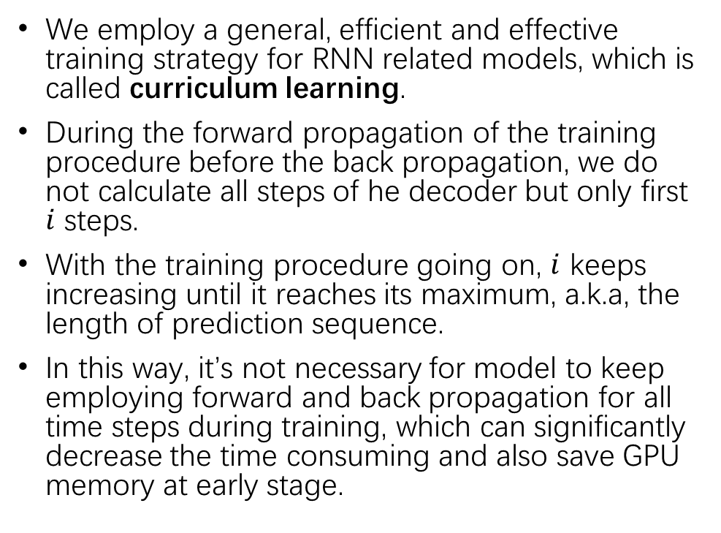
Training Strategy
We employ a general, efficient and effective training strategy for RNN related models, which is called curriculum learning.
During the forward propagation of the training procedure before the back propagation, we do not calculate all steps of he decoder but only first $i$ steps.
With the training procedure going on, $i$ keeps increasing until it reaches its maximum, a.k.a, the length of prediction sequence.
In this way, it’s not necessary for model to keep employing forward and back propagation for all time steps during training, which can significantly decrease the time consuming and also save GPU memory at early stage.

Slide 16
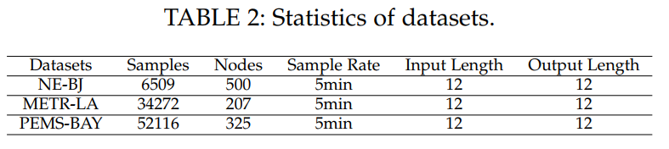
Datasets
METR-LA: A public traffic speed dataset collected from loop detectors in the highway of Los Angeles containing 207 selected sensors and ranging from Mar 1st 2012 to Jun 30th 2012.
PEMS-BAY: A public traffic speed dataset collected by California Transportation Agencies (CalTrans) containing 325 sensors in the Bay Area ranging from Jan 1st 2017 to May 31th 2017.
NE-BJ: Collected and extracted from navigation data of Tencent Map in weekdays of July 2020, which contains 500 road segments selected on the main roads in the northeast area of Beijing where a lot more traffic congestion always happens. The NE-BJ dataset is composed of traffic speed data of corresponding road segments seen as nodes in the graph.

Slide 17
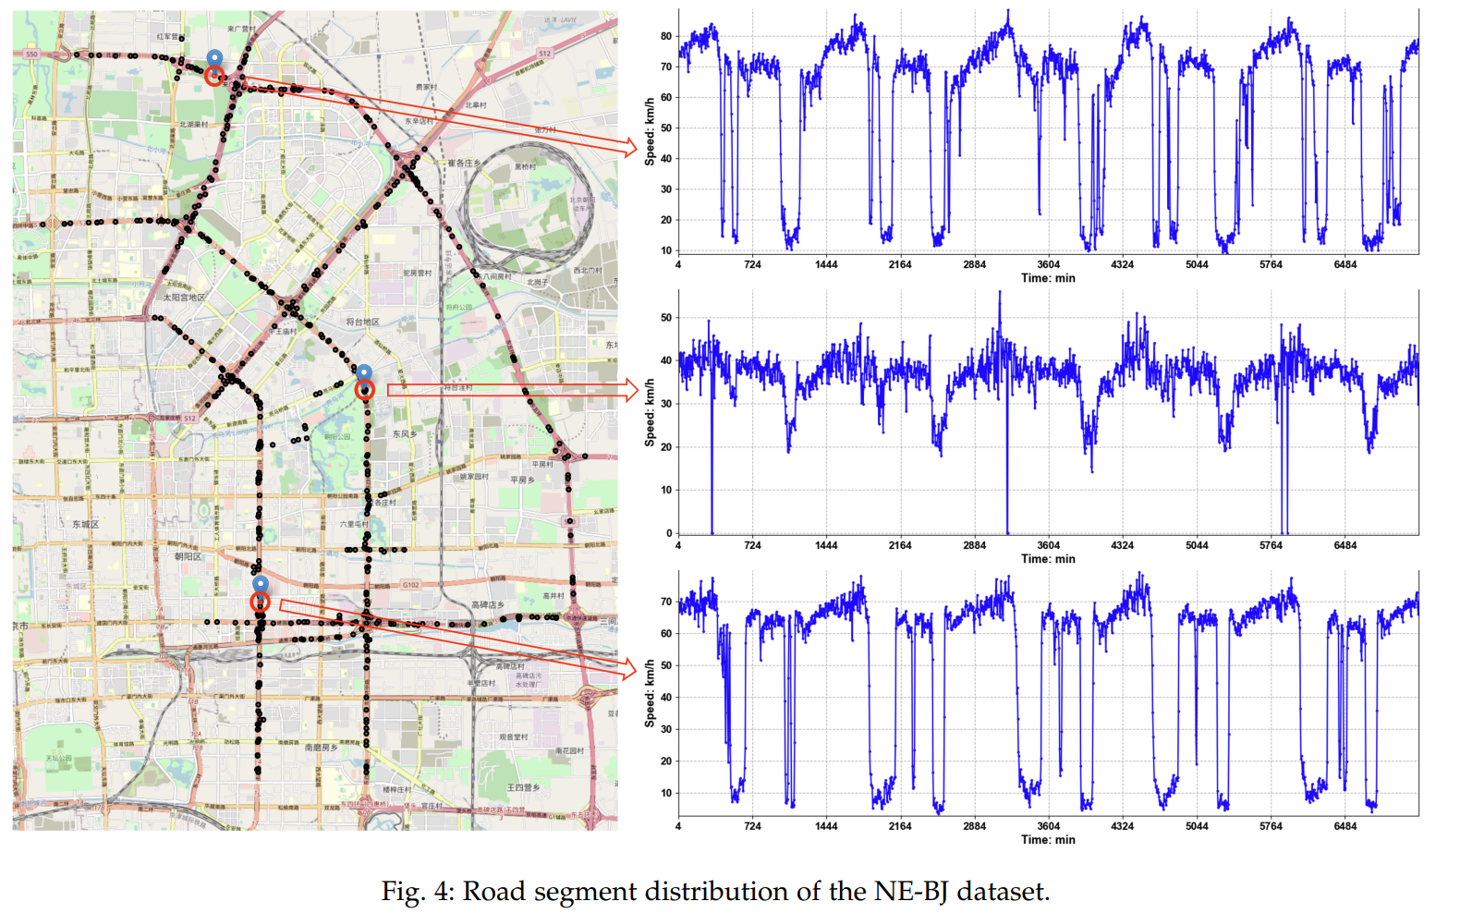
NE-BJ

Slide 18
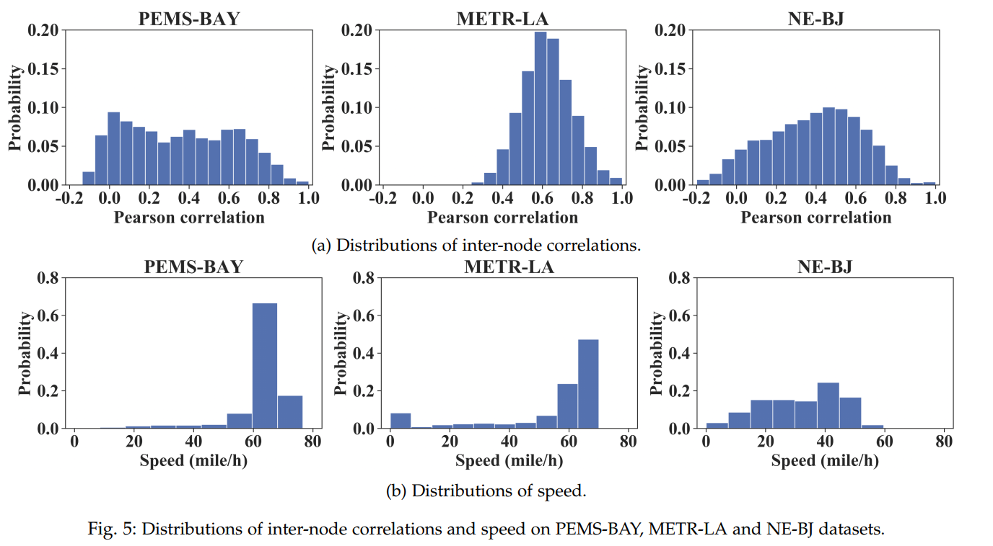
Pearson correlations

Slide 19
Baselines
HA: Historical Average (HA) method
SVR: Support Vector Regression (SVR)
FNN: forward neural network
ARIMA: Auto-Regressive Integrated Moving Average model
FC-LSTM: Long Short Term Memory (LSTM) network with fully connected hidden units
DCRNN: This is a GNN-based and RNN-based model which integrates GRU with dual directional diffusion convolution

Slide 20
Baselines
STGCN: It is a GNN-based and CNN-based model which incorporates graph convolutions with 1D convolutions.
Graph WaveNet: It is a GNN-based and CNN based model which integrates diffusion graph convolutions with gated 1D dilated convolutions and propose self-adaptive adjacency matrix.
……
MTGNN: It is a GNN-based and CNN-based model which employs adaptive graph, mix-hop propagation layers and dilated inception layers to capture spatio-temporal correlations.

Slide 21
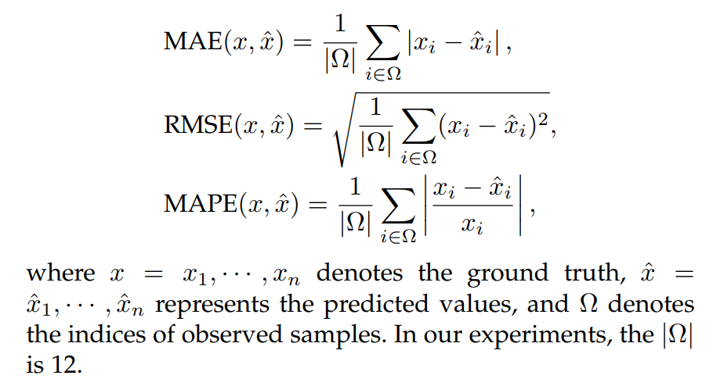
Evaluation Metrics

Slide 22
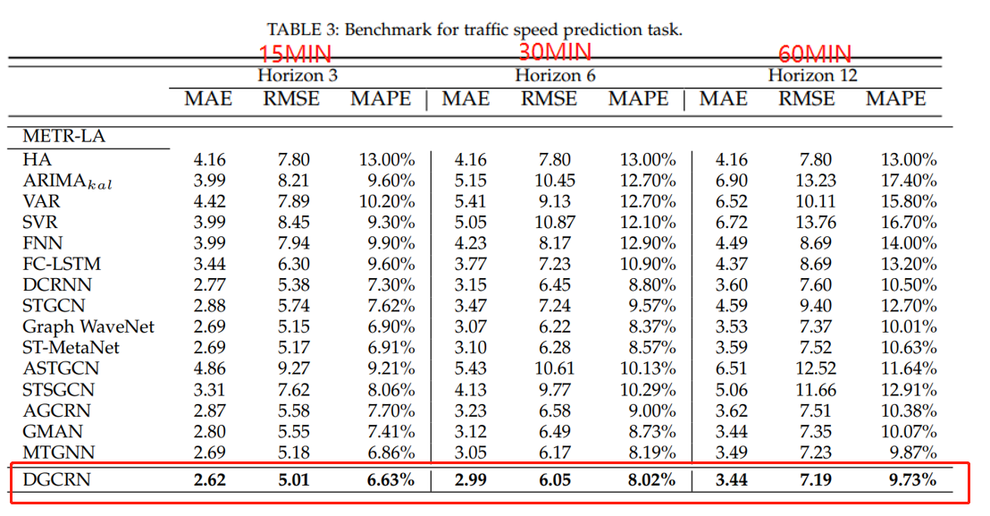
Traffic Benchmark

Slide 23
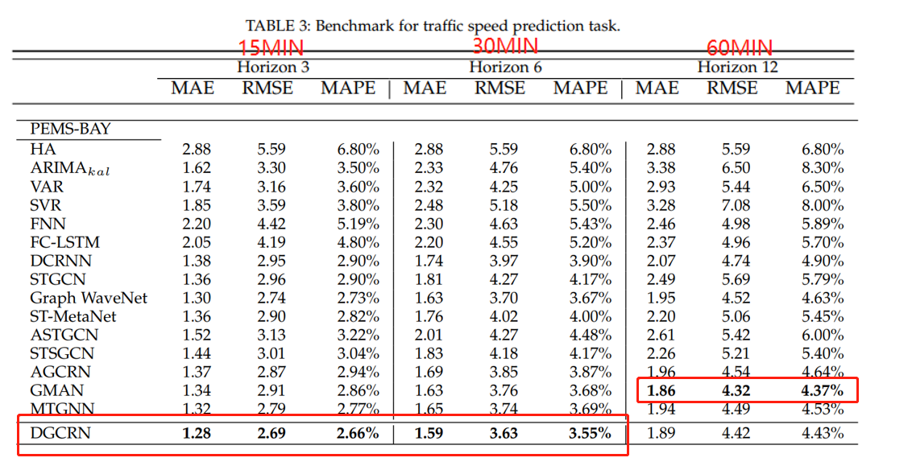
Traffic Benchmark

Slide 24
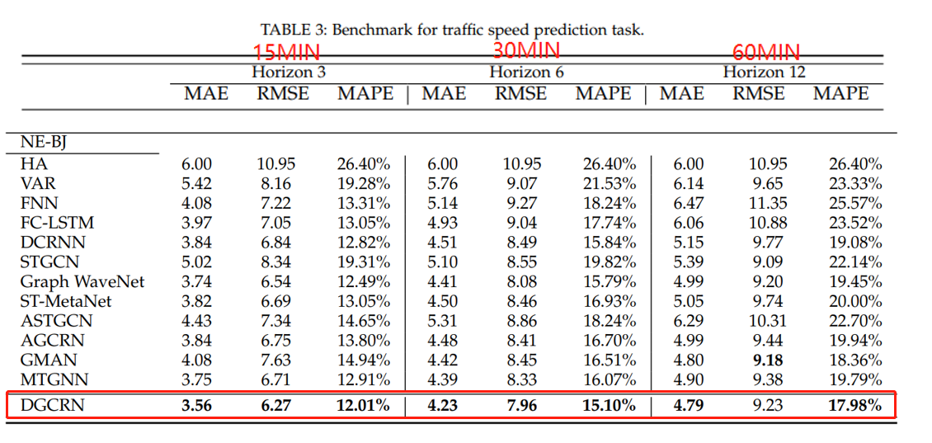
Traffic Benchmark

Slide 25
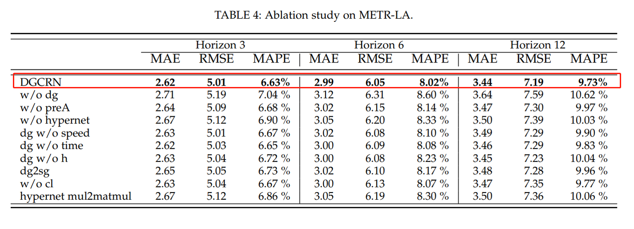
Ablation Study on METR-LA

Slide 26
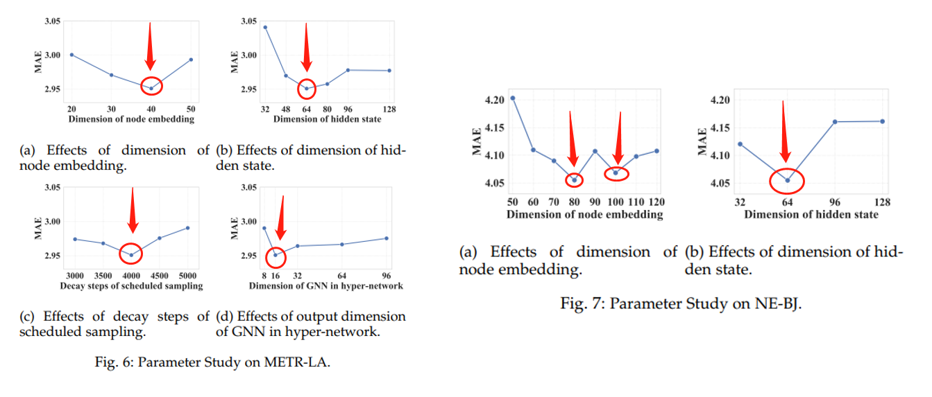
Parameter Study

Slide 27
Conclusion
Based on dynamic graph generation, propose DGCRN for traffic prediction. Employ a general training method for RNNs, which is proven more efficient and good for performance.
The NE-BJ dataset is representative for urban traffic conditions with great value for further research.
Provide the traffic benchmark for researchers to conduct fair comparisons of different methods and design their own models conveniently.
Conduct sufficient experiments to prove the dynamic graph generation is promising.

